Slide 1
Cloud Deployment Models
INDEX.HTML

Slide 2
Extractor
GO!

Slide 3
Contents
1.Introduction to AWS
2.Project Description (Services being used and how)
3.Working
4.References

Slide 4

01
Introduction to AWS

Slide 5
Amazon Web Services (AWS)
Amazon Web Services(AWS) is a subsidiary of e-commerce retailer Amazon.com launched in 2006.
It’s a constantly refurbishing cloud computing platform that provides us with a mixture of various Iaas, paas and Saas services.
AWS offers us with metered, pay-as-you-go computing services(one of the first to introduce such services), including virtual servers, APIs, storage, networking, database,content delivery, DevOps, Blockchain, Artificial Intelligence and more.
Diverse groups of institutions be it government, educational, private or non-profits can easily use AWS for their various needs.

Slide 6
02
Project Description
(Services being used and how)
01
Table of contents
02
03

Slide 7
AWS Services used
API Gateway(Rest API)
Amazon S3
AWS Identity and Access Management (IAM)
AWS Lambda
Amazon CloudWatch
Textract
Comprehend
Amazon Polly

Slide 8
Other services used
1.Postman
2.AWS SDK for Python (Boto3)

Slide 9
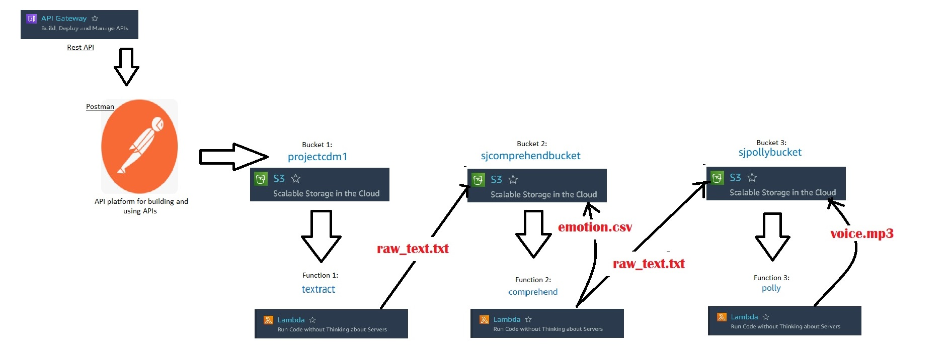
Basic overview of our Project

Slide 10

API Gateway
01
02
03
Amazon API Gateway is a fully managed service that makes it easy for developers to create, publish, maintain, monitor, and secure APIs at any scale. APIs act as the "front door" for applications to access data, business logic, or functionality from your backend services. Using API Gateway, you can create RESTful APIs and WebSocket APIs that enable real-time two-way communication applications. API Gateway supports containerized and serverless workloads, as well as web applications.
A REST API in API Gateway is a collection of resources and methods that are integrated with backend HTTP endpoints, Lambda functions, or other AWS services. You can use API Gateway features to help you with all aspects of the API lifecycle, from creation through monitoring your production APIs.

Slide 11
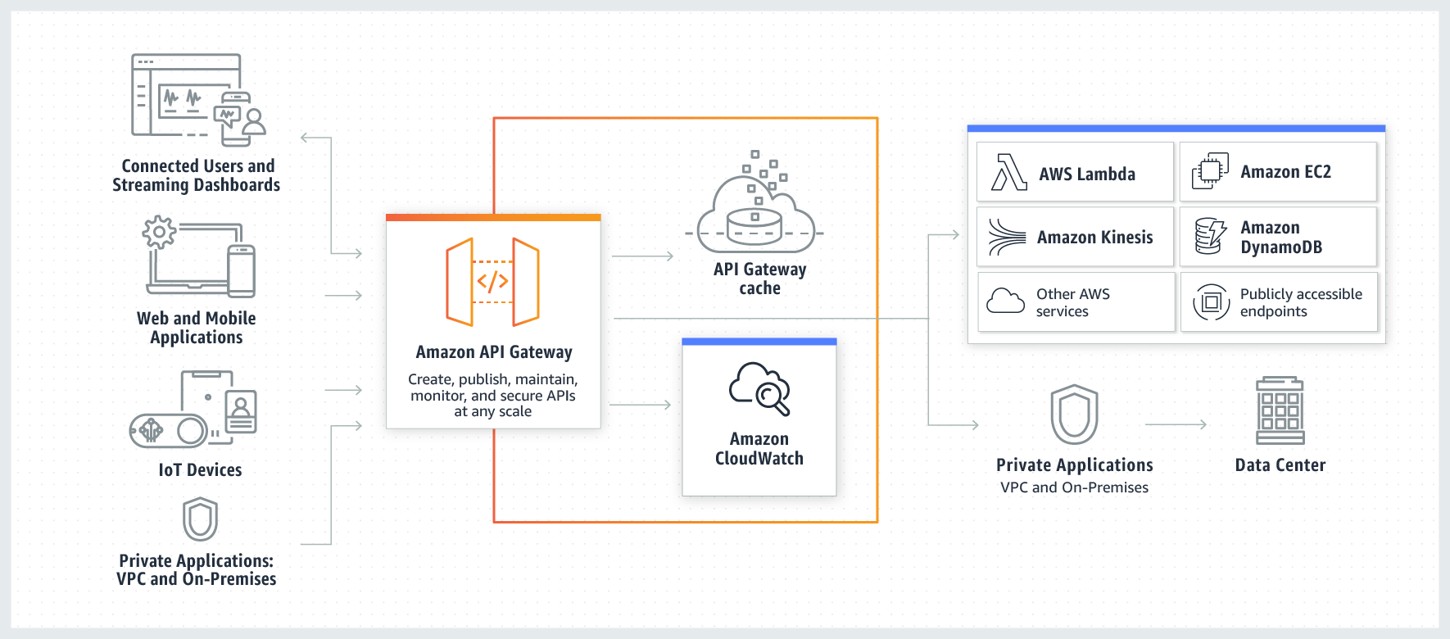

Slide 12
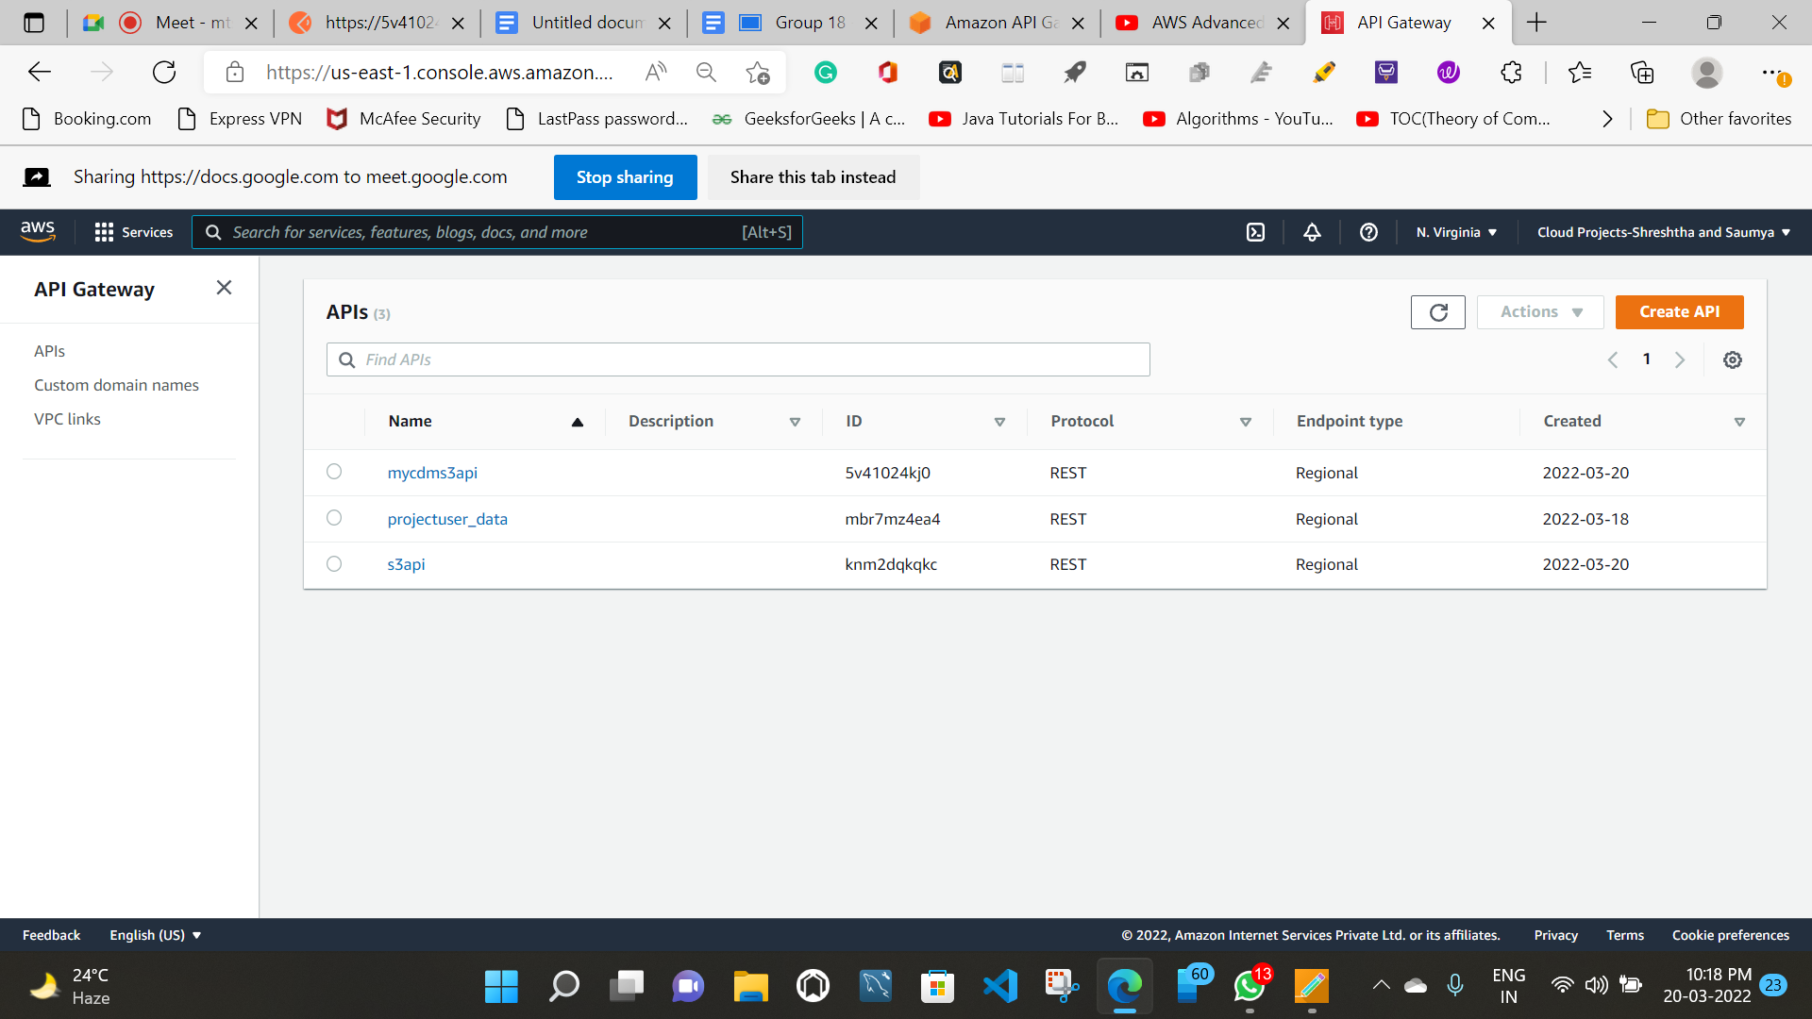
In our project we have created an api gateway to upload files directly in our S3 bucket (“projectcdm1”). We use Postman as an api client here with the PUT method.

Slide 13

Amazon S3
Amazon Simple Storage Service (Amazon S3) is an object storage service offering industry-leading scalability, data availability, security, and performance. Customers of all sizes and industries can store and protect any amount of data for virtually any use case, such as data lakes, cloud-native applications, and mobile apps. With cost-effective storage classes and easy-to-use management features, you can optimize costs, organize data, and configure fine-tuned access controls to meet specific business, organizational, and compliance requirements.

Slide 14
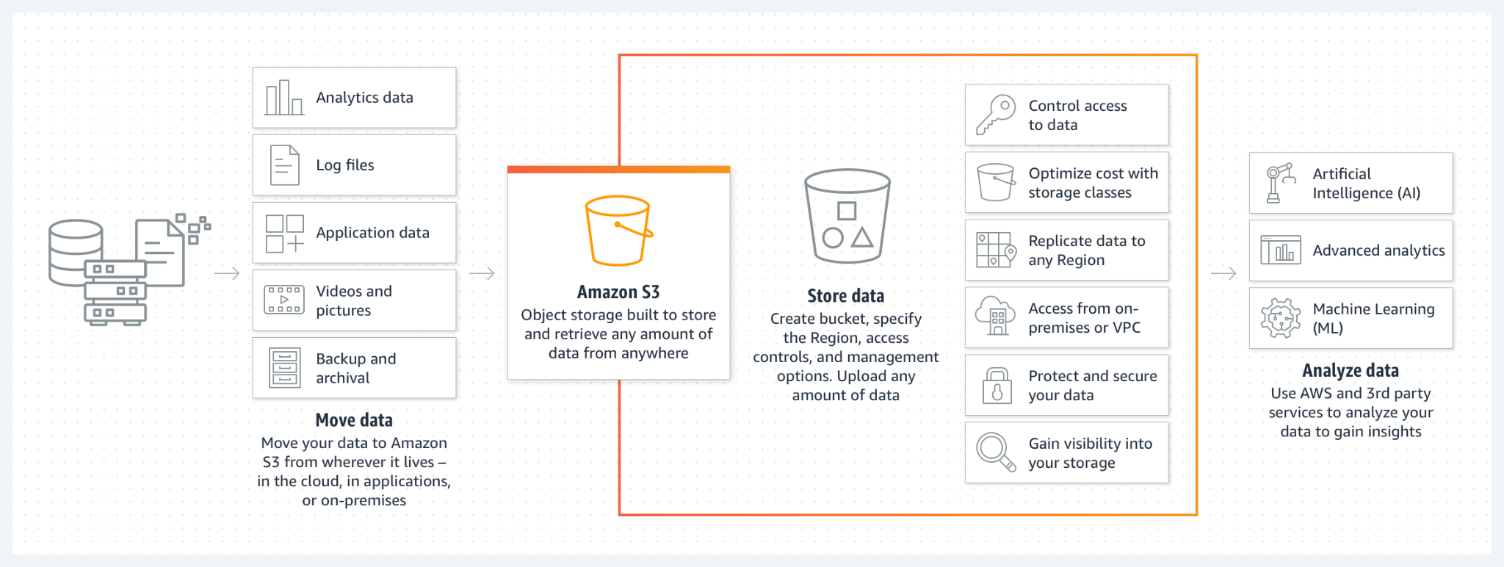

Slide 15
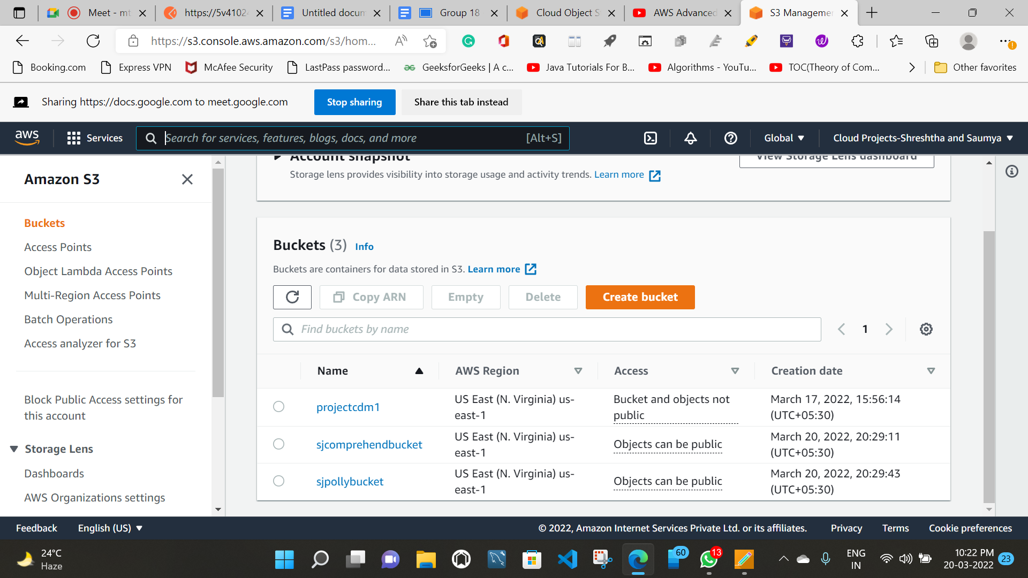
In our project we have used s3 bucket to store images in preferably an image file, which can be uploaded via any api client.

Slide 16

AWS Identity and Access Management (IAM)
AWS Identity and Access Management (IAM) provides fine-grained access control across all of AWS. With IAM, you can specify who can access which services and resources, and under which conditions. With IAM policies, you manage permissions to your workforce and systems to ensure least-privilege permissions.

Slide 17
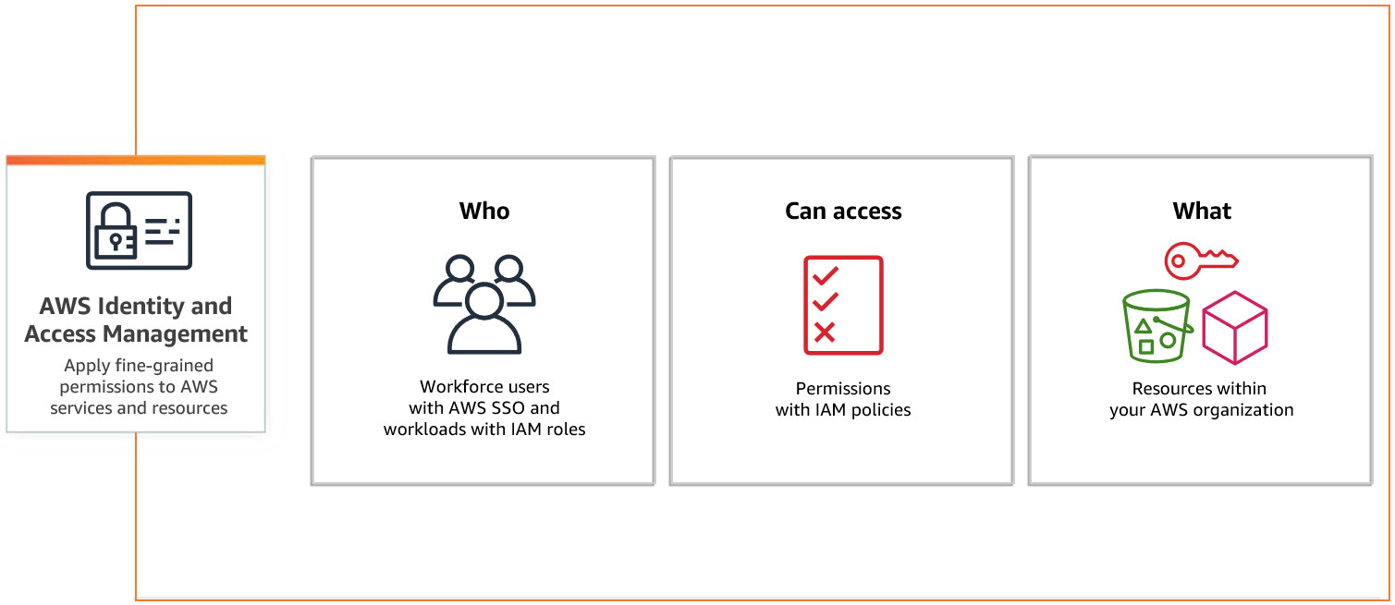

Slide 18
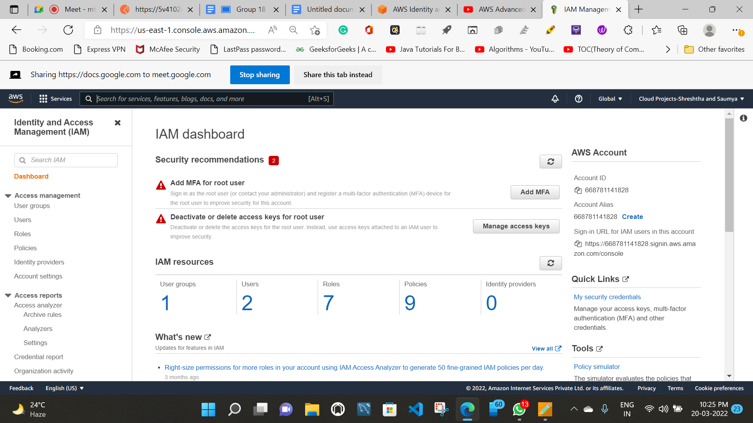
In our project we have used IAM , to create and attach roles and policies.

Slide 19
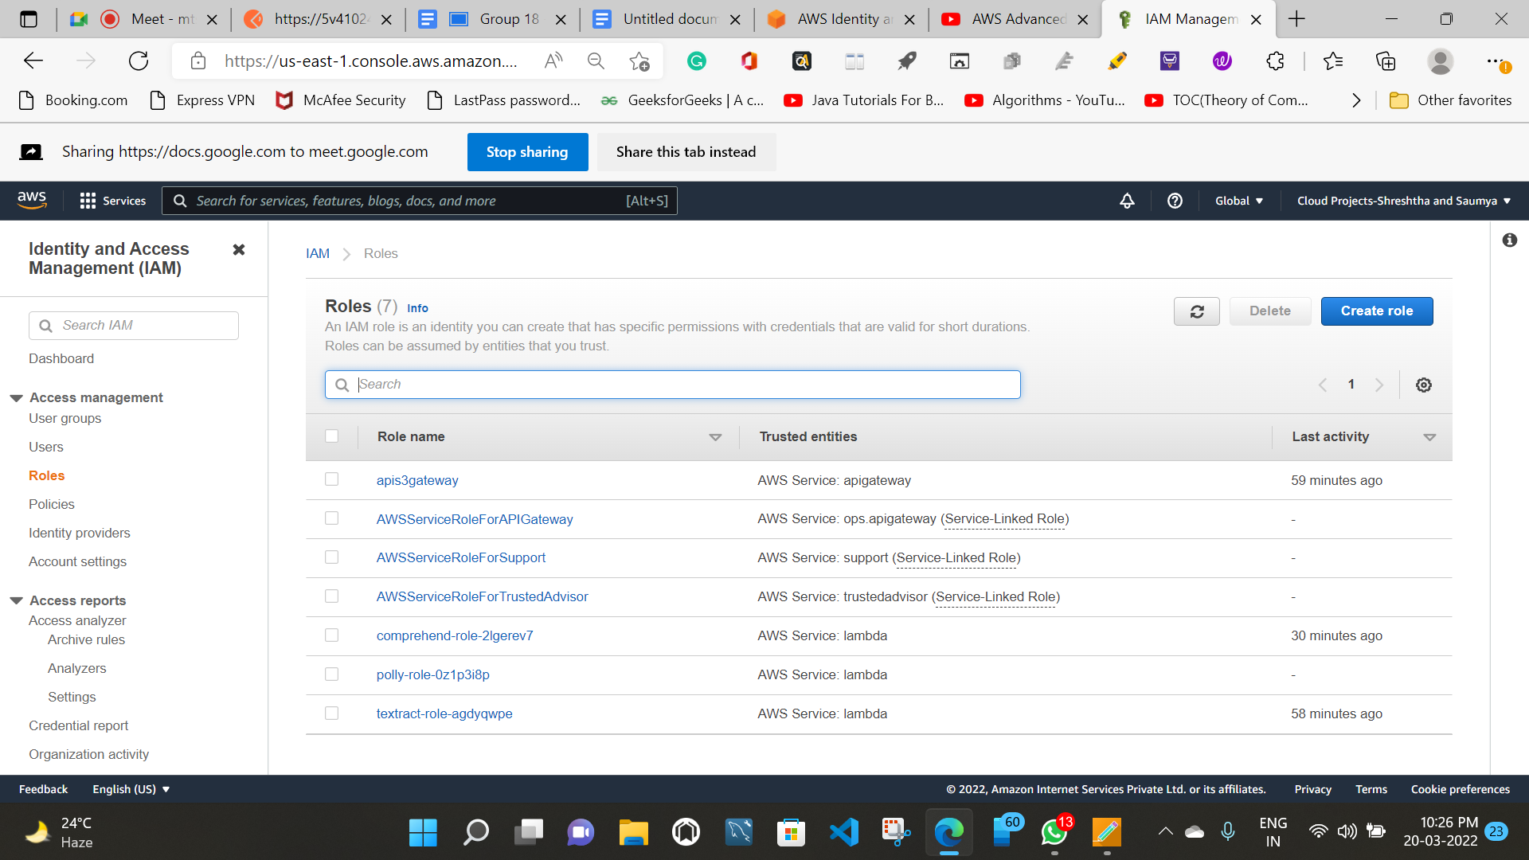

Slide 20
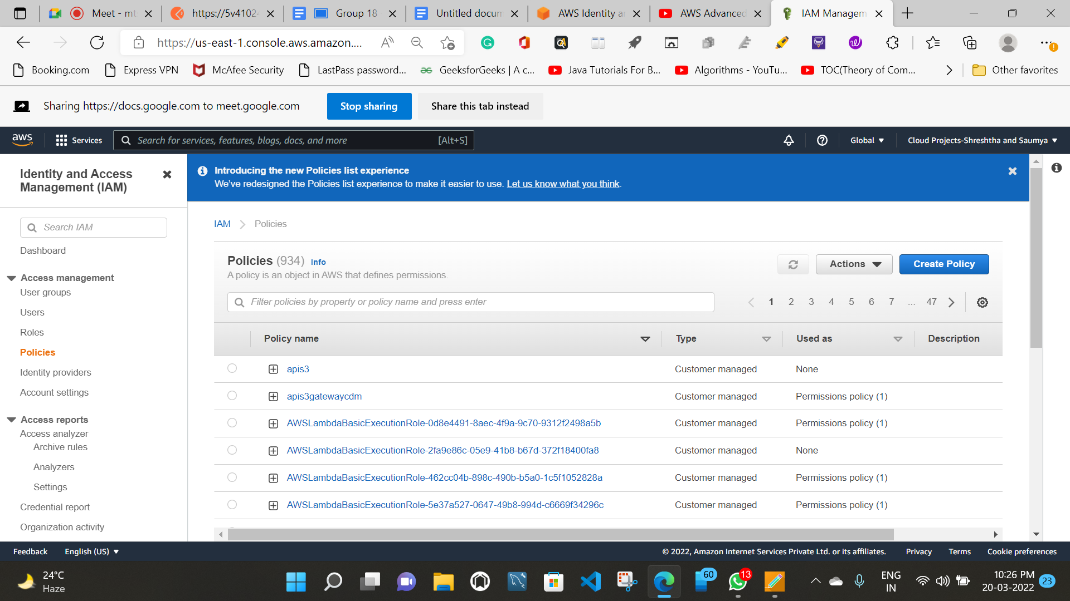

Slide 21

AWS Lambda
AWS Lambda is a serverless, event-driven compute service that lets you run code for virtually any type of application or backend service without provisioning or managing servers. You can trigger Lambda from over 200 AWS services and software as a service (SaaS) applications, and only pay for what you use.

Slide 22
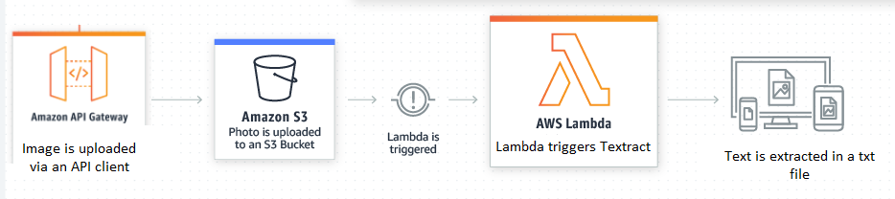

Slide 23
In our project we have used lambda to create various functions that will be triggered automatically as soon as a file(image) is uploaded in s3 bucket projectcdm1.

Slide 24
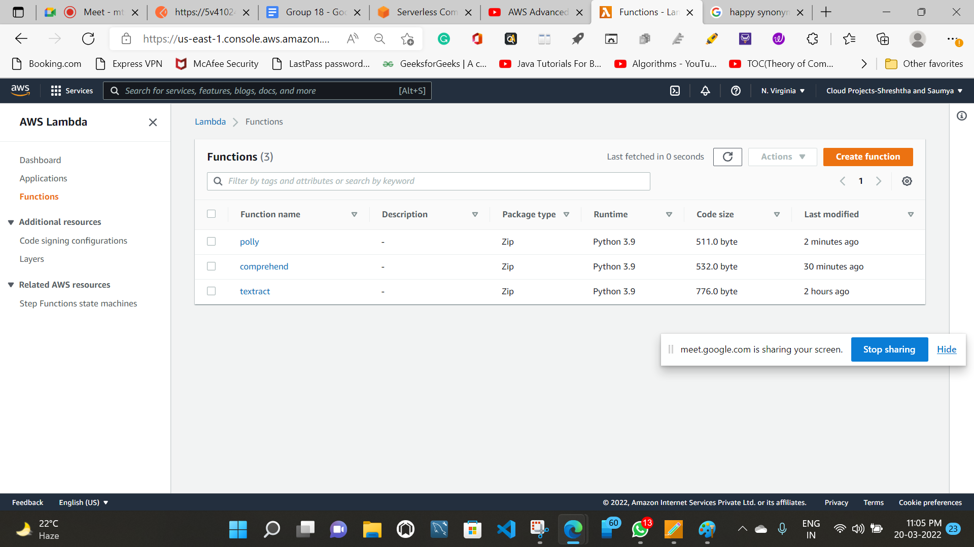

Slide 25

Amazon CloudWatch
Amazon CloudWatch is a monitoring and observability service built for DevOps engineers, developers, site reliability engineers (SREs), IT managers, and product owners. CloudWatch provides you with data and actionable insights to monitor your applications, respond to system-wide performance changes, and optimize resource utilization. CloudWatch collects monitoring and operational data in the form of logs, metrics, and events. You get a unified view of operational health and gain complete visibility of your AWS resources, applications, and services running on AWS and on-premises. You can use CloudWatch to detect anomalous behavior in your environments, set alarms, visualize logs and metrics side by side, take automated actions, troubleshoot issues, and discover insights to keep your applications running smoothly.

Slide 26
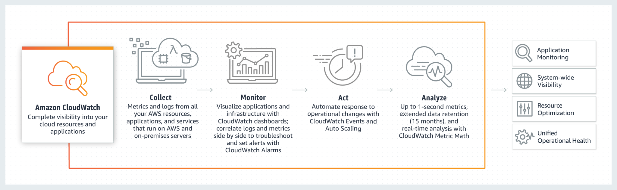

Slide 27
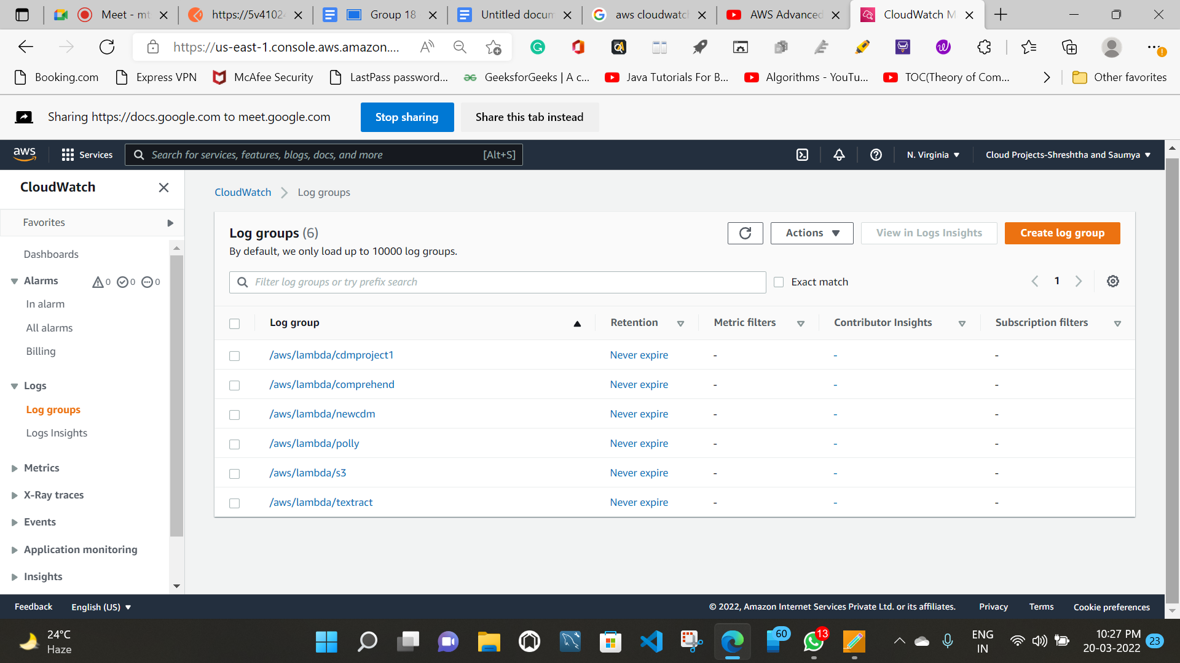
In our project we have used cloudwatch for observing our various lambda function triggers.

Slide 28

Textract
Amazon Textract is a machine learning (ML) service that automatically extracts text, handwriting, and data from scanned documents. It goes beyond simple optical character recognition (OCR) to identify, understand, and extract data from forms and tables.

Slide 29
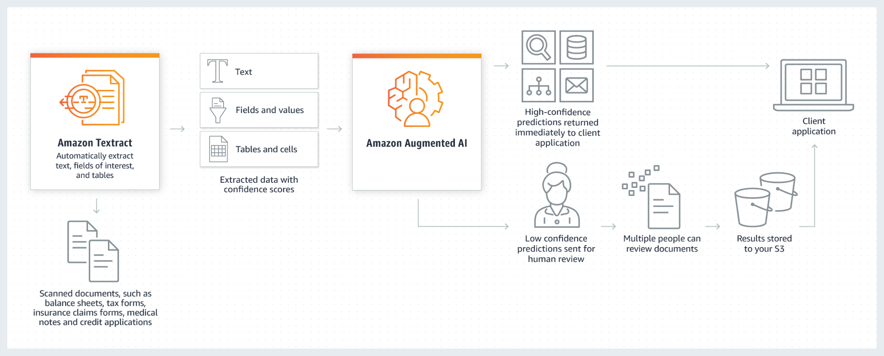

Slide 30
In our project we are extracting words line by line from a preferably from an image and uploading it’s respective extracted words in a txt file in another bucket “sjcomprehendbucket”

Slide 31
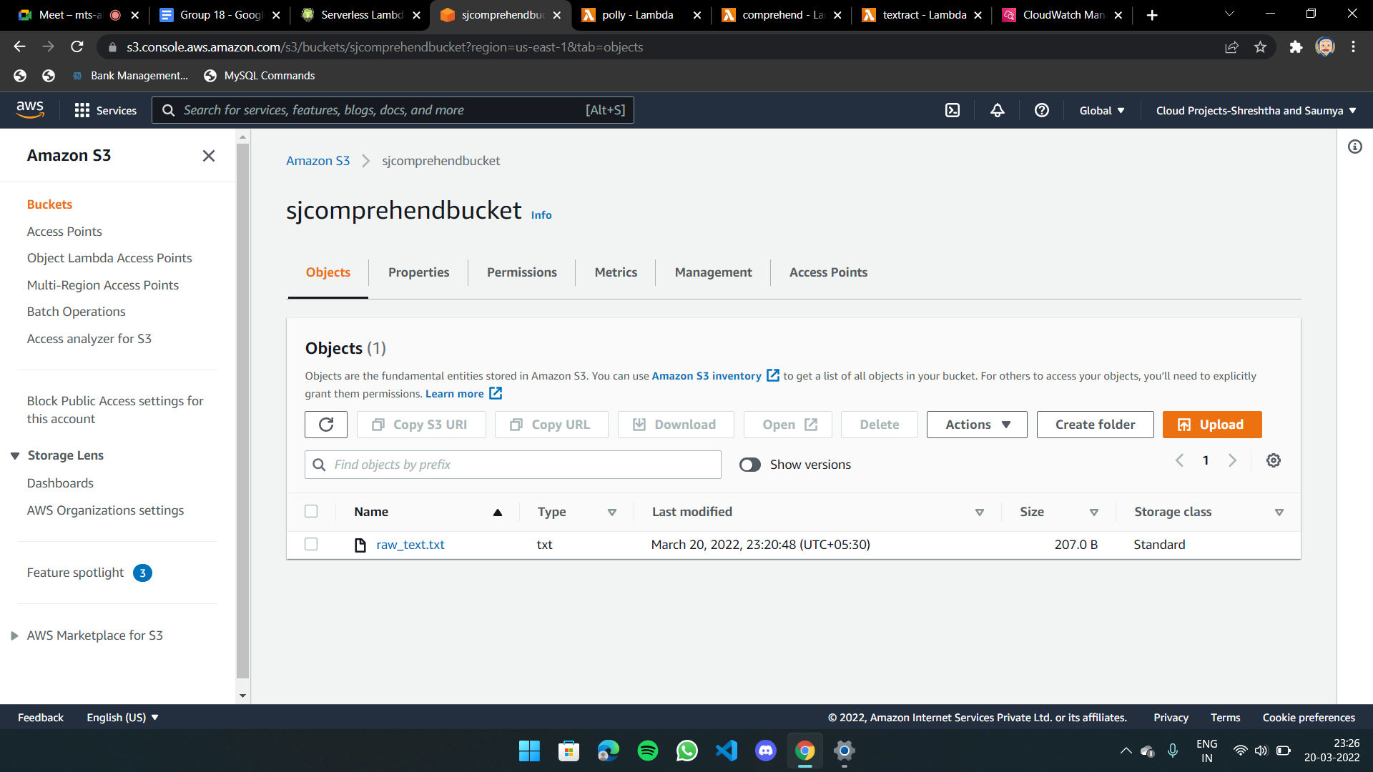

Slide 32
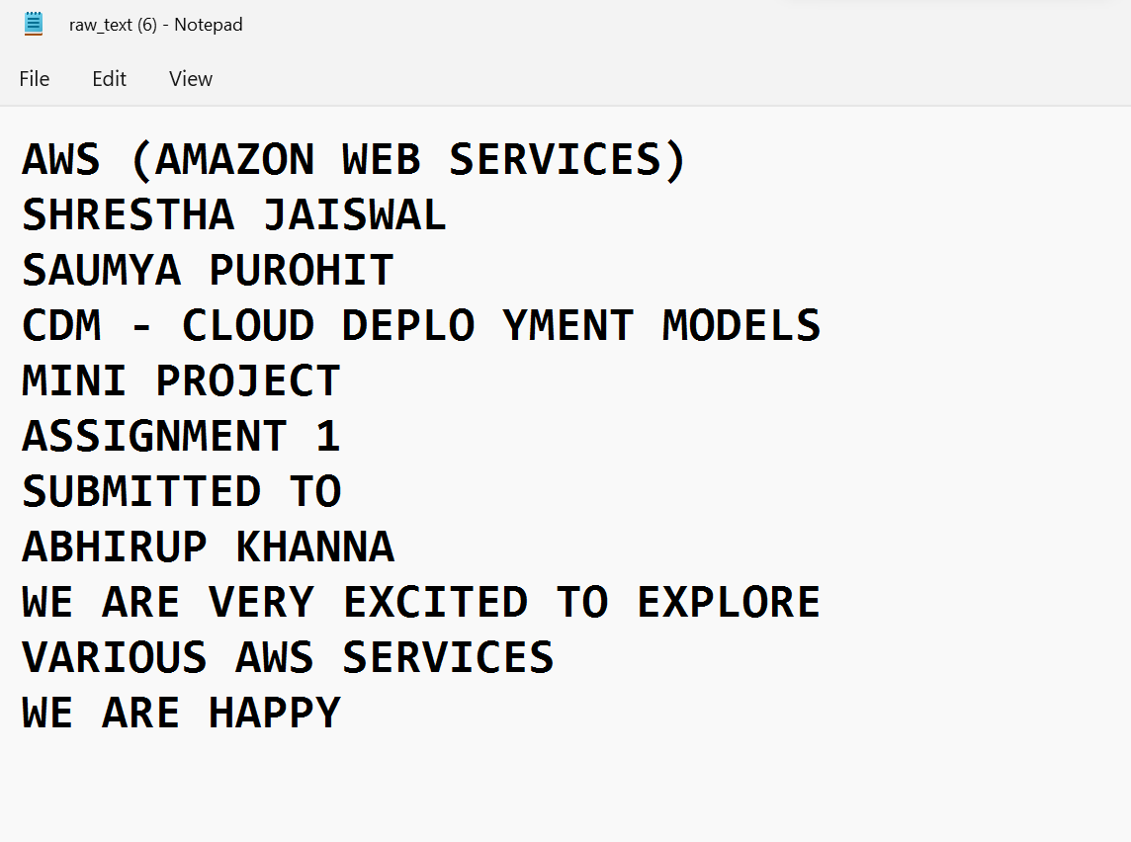
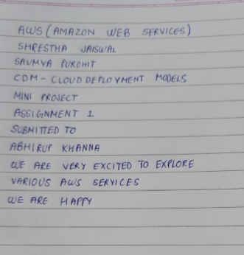

Slide 33

Comprehend
Amazon Comprehend is a natural-language processing (NLP) service that uses machine learning to uncover valuable insights and connections in text.

Slide 34
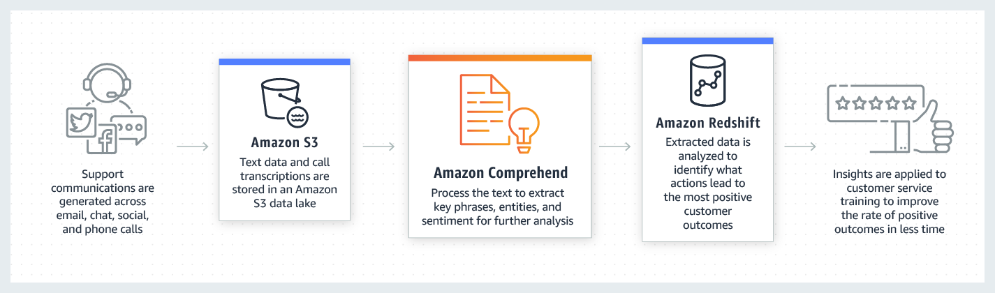

Slide 35
In our project after textract extracts text from our image file it stores data in the form of a txt file in sjcomprehendbucket.

Slide 36
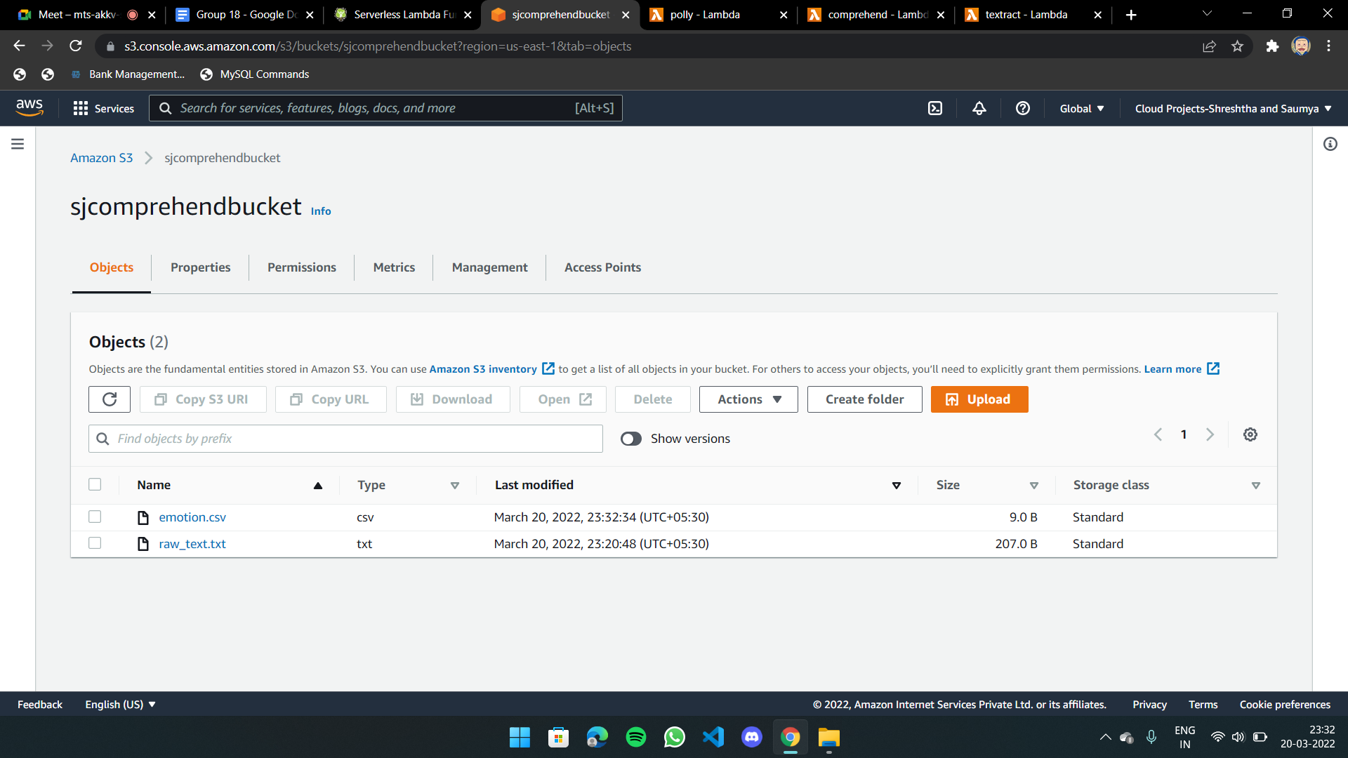

Slide 37
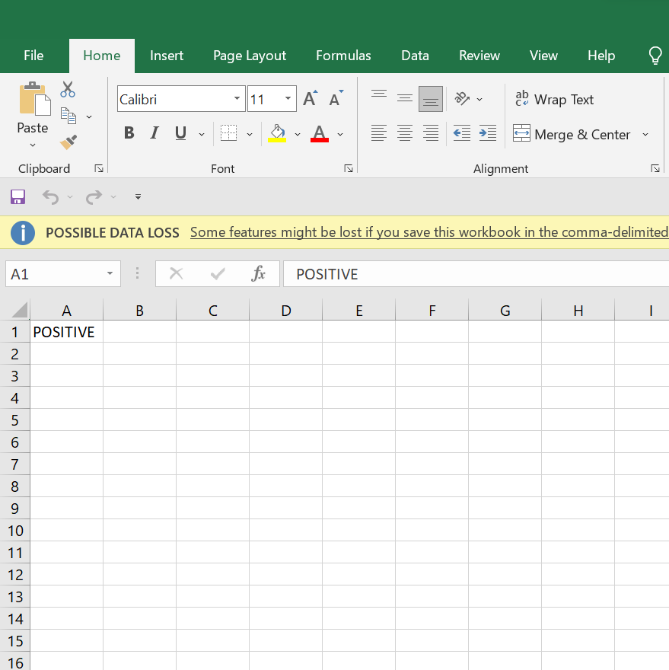

Slide 38

Amazon Polly
Amazon Polly is a service that turns text into lifelike speech, allowing you to create applications that talk, and build entirely new categories of speech-enabled products. Polly's Text-to-Speech (TTS) service uses advanced deep learning technologies to synthesize natural sounding human speech. With dozens of lifelike voices across a broad set of languages, you can build speech-enabled applications that work in many different countries.
In addition to Standard TTS voices, Amazon Polly offers Neural Text-to-Speech (NTTS) voices that deliver advanced improvements in speech quality through a new machine learning approach. Polly’s Neural TTS technology also supports a Newscaster speaking style that is tailored to news narration use cases.

Slide 39
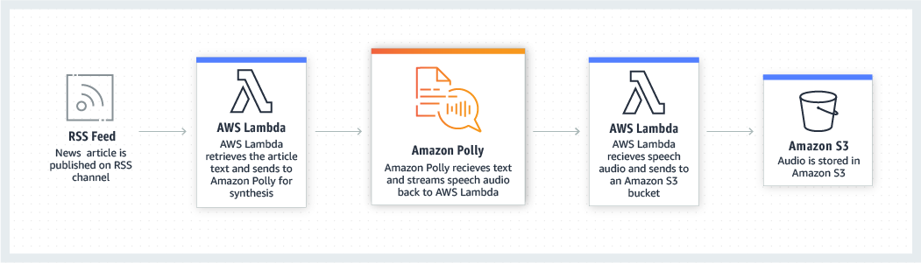

Slide 40
In our project we are using the voice of “Matthew”. After comprehend has analyzed the emotions we have extracted from the uploaded text of the image file, it creates a copy of raw data in sjpollybucket and polly uploads an mp3 file in the same bucket.

Slide 41
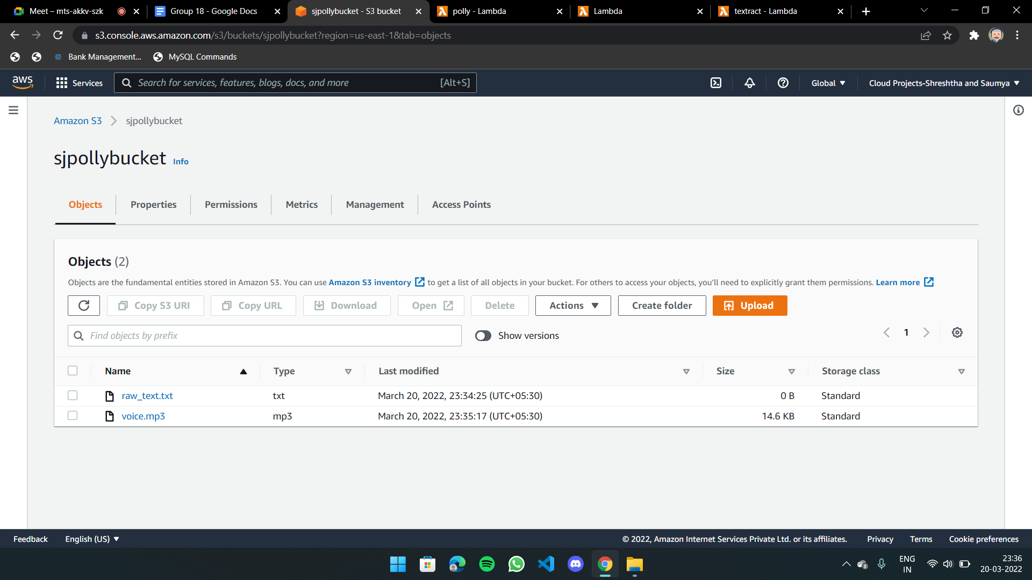

Slide 42

Postman
Postman is an application used for API testing. It is an HTTP client that tests HTTP requests, utilizing a graphical user interface, through which we obtain different types of responses that need to be subsequently validated.

Slide 43
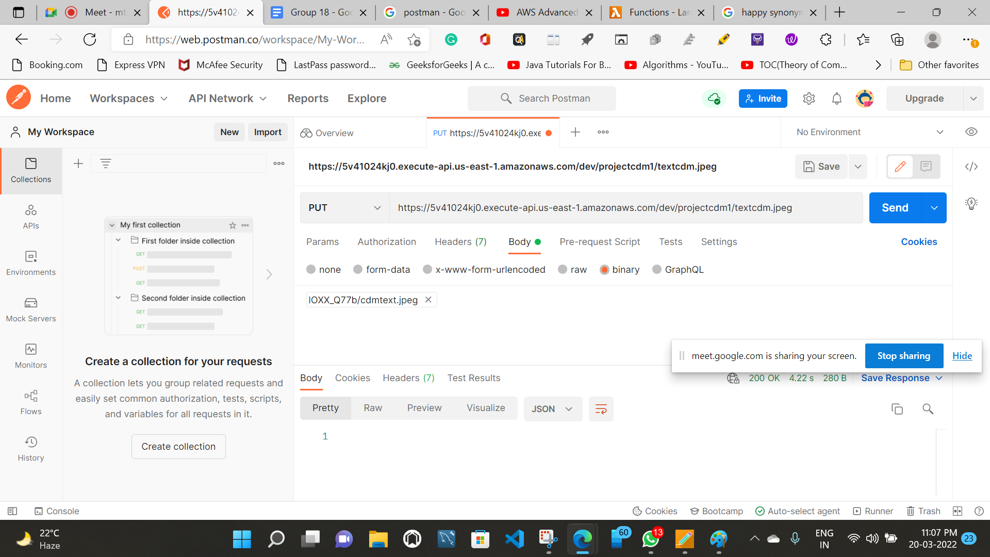

Slide 44
AWS SDK for Python (Boto3)
Boto3 makes it easy to integrate your Python application, library, or script with AWS services including Amazon S3, Amazon EC2, Amazon DynamoDB, and more

Slide 45
03
Working

Slide 46
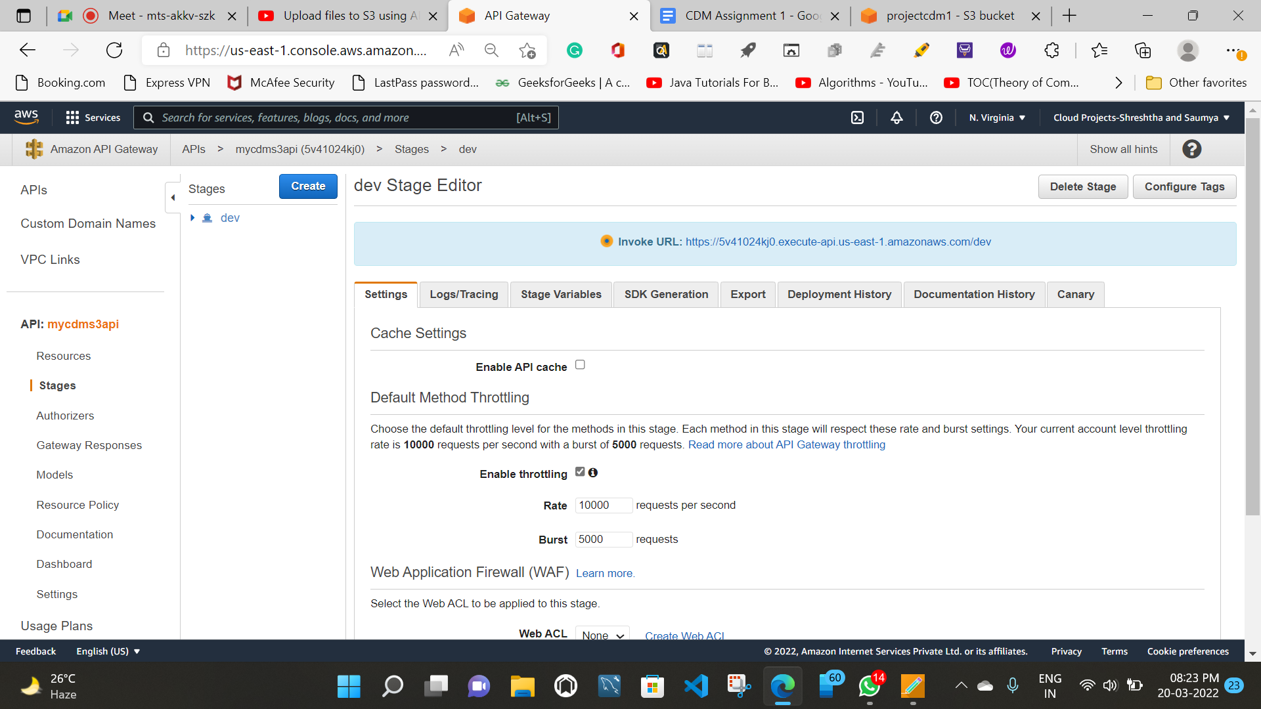
Postman:-
https://www.postman.com/
AWS Management Console:-
https://aws.amazon.com/console/
Invoke URL:-
https://5v41024kj0.execute-api.us-east-1.amazonaws.com/dev

Slide 47
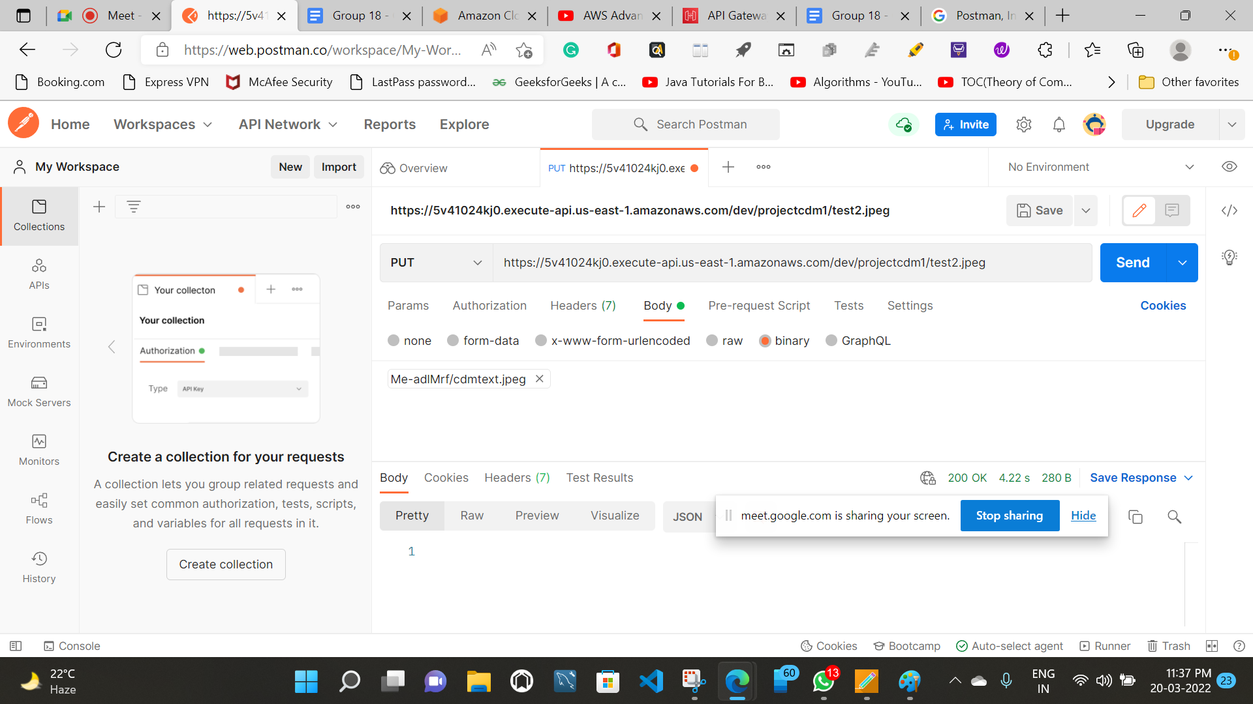

Slide 48
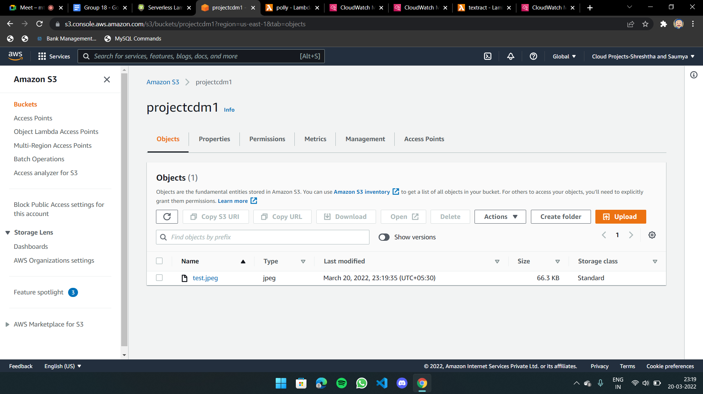

Slide 49
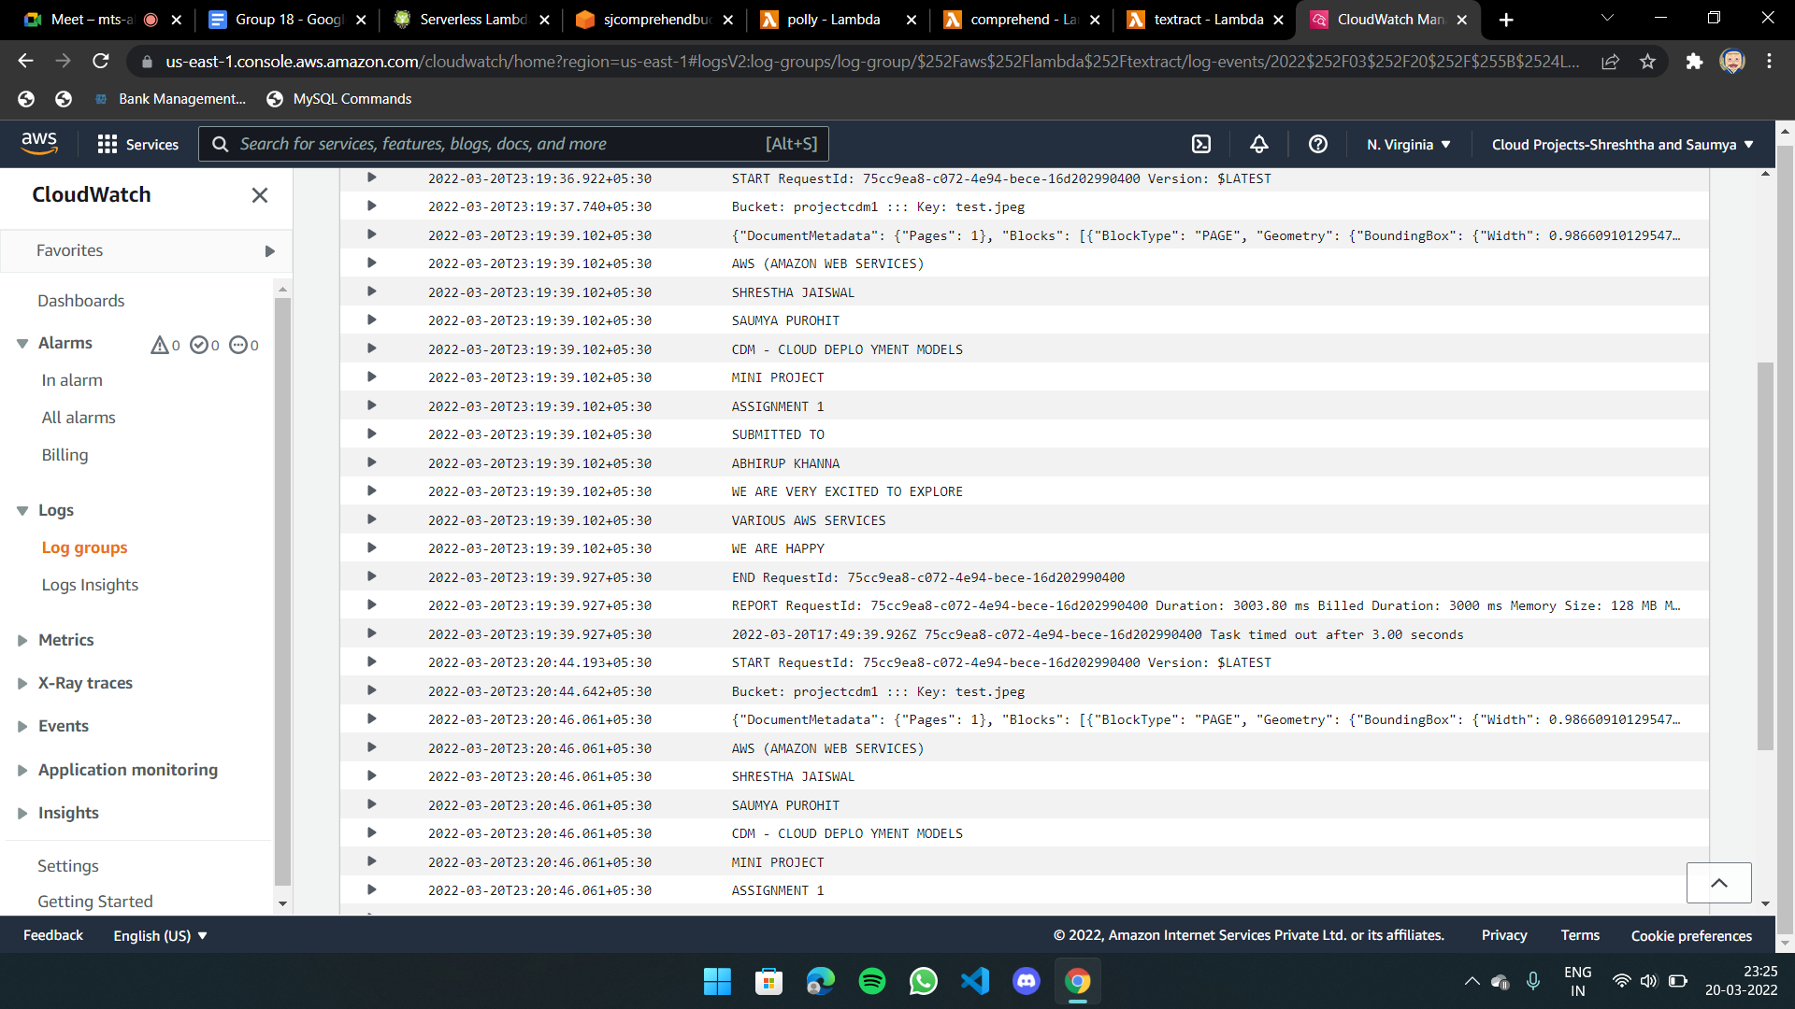

Slide 50
Textract function code
import json
import boto3
from urllib.parse import unquote_plus
def extract_text(response, extract_by="LINE"):
line_text = []
str1 = "\n"
for block in response["Blocks"]:
if block["BlockType"] == extract_by:
line_text.append(block["Text"])
return str1.join(line_text)

Slide 51
def lambda_handler(event, context):
textract = boto3.client("textract")
if event:
file_obj = event["Records"][0]
bucketname = str(file_obj["s3"]["bucket"]["name"])
filename = unquote_plus(str(file_obj["s3"]["object"]["key"]))
print(f"Bucket: {bucketname} ::: Key: {filename}")
response = textract.detect_document_text(
Document={
"S3Object": {
"Bucket": bucketname,
"Name": filename,
}
}
)
print(json.dumps(response))

Slide 52
# change LINE by WORD if you want word level extraction
raw_text = extract_text(response, extract_by="LINE")
print(raw_text)
s3 = boto3.client("s3")
bucket = "sjcomprehendbucket"
with open("/tmp/raw_text.txt", "w") as f:
f.write(str(raw_text))
client = boto3.resource("s3")
client.meta.client.upload_file("/tmp/raw_text.txt", bucket, "raw_text.txt")
return {
"statusCode": 200,
"body": json.dumps("Document processed successfully!"),
}
return {"statusCode": 500, "body": json.dumps("There is an issue!")}

Slide 53
References
01
02
AWS SDK for Python (amazon.com)
AWS Advanced - REST API for S3 with API Gateway
Amazon API Gateway | API Management | Amazon Web Services
Cloud Object Storage – Amazon S3 – Amazon Web Services
AWS Identity and Access Management - Amazon Web Services
Amazon CloudWatch - Application and Infrastructure Monitoring
Serverless Computing - AWS Lambda - Amazon Web Services
Intelligently Extract Text & Data with OCR - Amazon Textract - Amazon Web Services
Amazon Polly
Natural Language Processing – Amazon Comprehend – Amazon Web Services
03

Slide 54
Project using Lambda (Python), API Gateway, S3, Athena, postman with step by step explanation, guide
https://youtube.com/playlist?list=PL8tc66sMn9Kg05l6kvL_ujHKfaLi3fHLH
https://youtu.be/dir1HtgbwzY
https://youtu.be/XgMqUPskDlo
https://youtu.be/-8L4OxotXlE
https://youtu.be/ijPOevW-ZOM
https://youtu.be/XgMqUPskDlo
https://youtu.be/7Gym2XVcA5A
https://youtu.be/E-WdMk7_IQo

Slide 55
PRESENTATION BY:
SHRESTHA JAISWAL
&
SAUMYA PUROHIT
GO!

